Slide 1
Sampling
Sampling can be used as a data reduction technique because it allows a large data set to be represented by a much smaller random data sample (or subset). Suppose that a large data set, D, contains N tuples. Let’s look at the most common ways that we could sample D for data reduction.
Simple random sample without replacement (SRSWOR)
Simple random sample with replacement (SRSWR)
Cluster sample
Stratified sampling

Slide 2
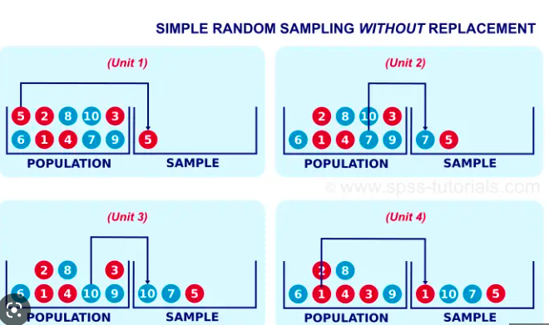
SRSWOR
Simple random sample without replacement (SRSWOR) of size s: SRSWOR is a method of selection of n units out of the N units one by one such that at any stage of selection, any one of the remaining units have the same chance of being selected.

Slide 3
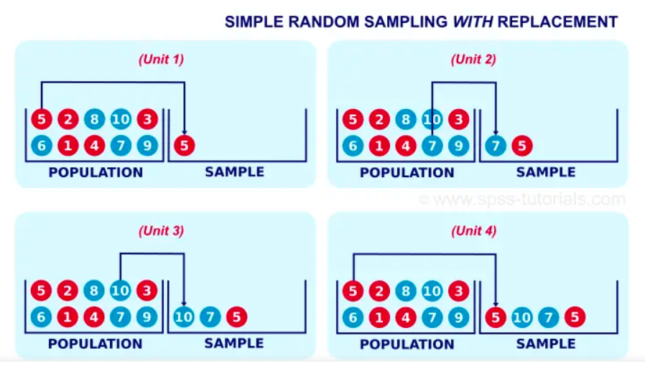
SRSWR
Simple random sample with replacement (SRSWR) of size s: This is similar to SRSWOR, except that each time a tuple is drawn from D, it is recorded and then replaced. That is, after a tuple is drawn, it is placed back in D so that it may be drawn again. or
SRSWR is a method of selection of n units out of the N units one by one such that at each stage of selection, each unit has an equal chance of being selected.

Slide 4
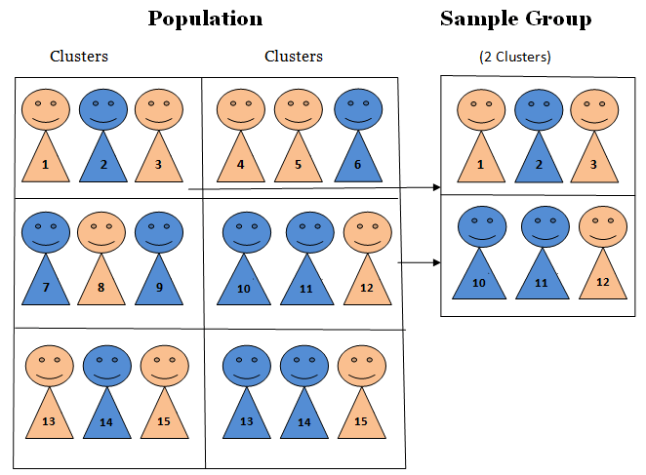
Cluster sample
If the tuples in D are grouped into M mutually disjoint “clusters,” then an SRS of s clusters can be obtained, where s < M. For example, tuples in a database are usually retrieved a page at a time, so that each page can be considered a cluster. A reduced data representation can be obtained by applying, say, SRSWOR to the pages, resulting in a cluster sample of the tuples. Other clustering criteria conveying rich semantics can also be explored. For example, in a spatial database, we may choose to define clusters geographically based on how closely different areas are located.

Slide 5
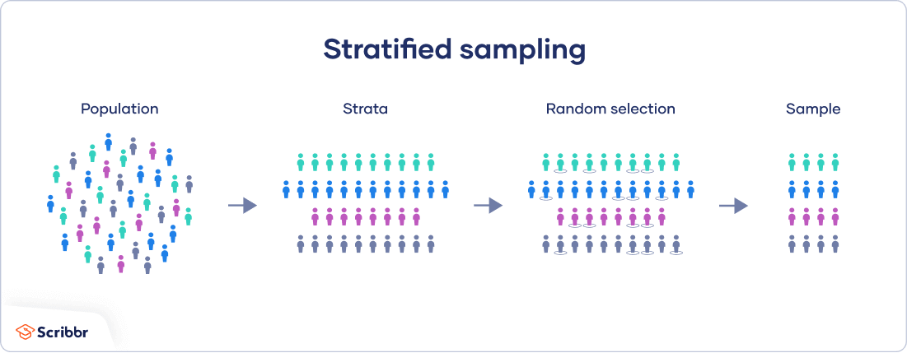
Stratified sample
If D is divided into mutually disjoint parts called strata, a stratified sample of D is generated by obtaining an SRS at each stratum. This helps ensure a representative sample, especially when the data are skewed. For example, a stratified sample may be obtained from customer data, where a stratum is created for each customer age group. In this way, the age group having the smallest number of customers will be sure to be represented.

Slide 6
Advantage of sampling
An advantage of sampling for data reduction is that the cost of obtaining a sample is proportional to the size of the sample, s, as opposed to N, the data set size. Hence, sampling complexity is potentially sublinear to the size of the data. Other data reduction techniques can require at least one complete pass through D. For a fixed sample size, sampling complexity increases only linearly as the number of data dimensions, n, increases, whereas techniques using histograms, for example, increase exponentially in n.

Slide 7
Data cleaning process contd..
The data should also be examined regarding unique rules, consecutive rules, and null rules.
A unique rule says that each value of the given attribute must be different from all other values for that attribute.
A consecutive rule says that there can be no missing values between the lowest and highest values for the attribute, and that all values must also be unique (e.g., as in check numbers).
A null rule specifies the use of blanks, question marks, special characters, or other strings values should be handled.

Slide 8
Data integration
Entity Identification Problem
Redundancy and Correlation Analysis
Tuple Duplication
Data Value Conflict Detection and Resolution

Slide 9
Data integration
Entity Identification Problem
Schema integration and object matching can be tricky.
How can equivalent real-world entities from multiple data sources be matched up? This is referred to as the entity identification problem.
For example, how can the data analyst or the computer be sure that customer_id in one database and cust_number in another databases refer to the same attribute? Examples of metadata for each attribute include the name, meaning, data type, and range of values permitted for the attribute, and null rules for handling blank, zero, or null values.
Then matching attributes from one database to another during integration, special attention must be paid to the structure of the data.

Slide 10
Data integration
Redundancy and Correlation Analysis
An attribute (such as annual revenue, for instance) may be redundant if it can be “derived” from another attribute or set of attributes.
Inconsistencies in attribute or dimension naming can also cause redundancies in the resulting data set.
Some redundancies can be detected by correlation analysis.
For nominal data, we use the χ 2 (chi-square) test. For numeric attributes, we can use the correlation coefficient and covariance, both of which access how one attribute’s values vary from those of another

Slide 11
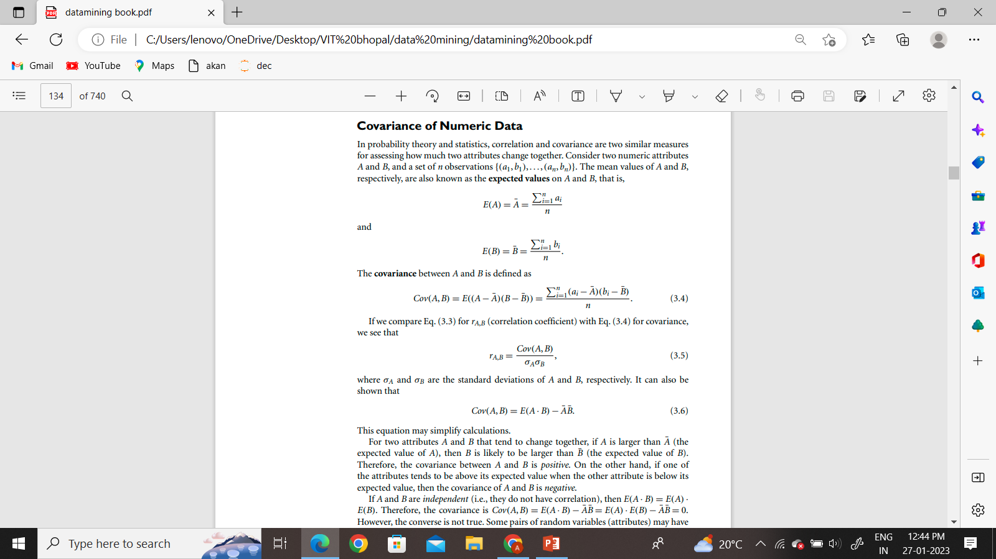
Covariance Analysis
Data integration

Slide 12
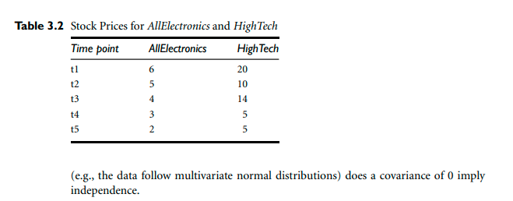
Data integration
Covariance Analysis
Q. Below table shows the stock prices observed at five time points for AllElectronics and HighTech, a high-tech company. If the stocks are affected by the same industry trends, will their prices rise or fall together?

Slide 13
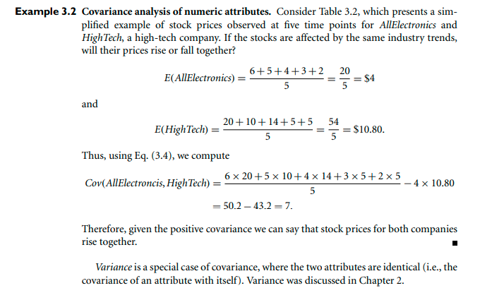
Covariance Analysis
Data integration

Slide 14

Data integration
Data integration
χ 2 Correlation Test for Nominal Data
For nominal data, a correlation relationship between two attributes, A and B, can be discovered by a χ 2 (chi-square) test. Suppose A has c distinct values, namely a1,a2,...ac . B has r distinct values, namely b1,b2,...br . The data tuples described by A and B can be shown as a contingency table, with the c values of A making up the columns and the r values of B making up the rows. Let (Ai ,Bj) denote the joint event that attribute A takes on value ai and attribute B takes on value bj , that is, where (A = ai ,B = bj). Each and every possible (Ai ,Bj) joint event has its own cell (or slot) in the table. The χ 2 value (also known as the Pearson χ 2 statistic) is computed as
where oij is the observed frequency (i.e., actual count) of the joint event (Ai ,Bj) and eij is the expected frequency of (Ai ,Bj), which can be computed as

Slide 15

χ 2 Correlation Test
Data integration
where n is the number of data tuples, count(A = ai) is the number of tuples having value ai for A, and count(B = bj) is the number of tuples having value bj for B.

Slide 16

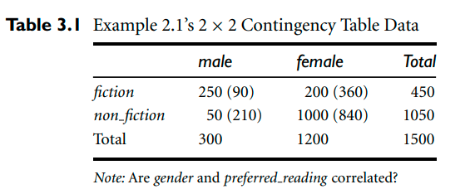
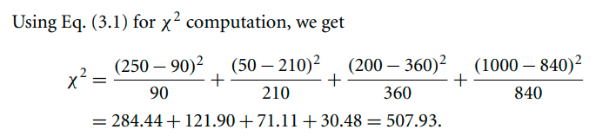
χ 2 Correlation Test
Data integration
Data integration
The χ 2 statistic tests the hypothesis that A and B are independent, that is, there is no correlation between them. The test is based on a significance level, with (r − 1) × (c − 1) degrees of freedom. We illustrate the use of this statistic in Example 3.1. If the hypothesis can be rejected, then we say that A and B are statistically correlated.

Slide 17
Data Transformation
In this preprocessing step, the data are transformed or consolidated so that the resulting mining process may be more efficient, and the patterns found may be easier to understand. Data discretization, is a form of data transformation. In data transformation, the data are transformed or consolidated into forms appropriate for mining. Strategies for data transformation include the following:

Slide 18
Data Transformation
Smoothing, which works to remove noise from the data. Techniques include binning, regression, and clustering.
Attribute construction (or feature construction), where new attributes are constructed and added from the given set of attributes to help the mining process.
Aggregation, where summary or aggregation operations are applied to the data. For example, the daily sales data may be aggregated so as to compute monthly and annual total amounts. This step is typically used in constructing a data cube for data analysis at multiple abstraction levels.
Normalization, where the attribute data are scaled so as to fall within a smaller range, such as −1.0 to 1.0, or 0.0 to 1.0.

Slide 19
Data Transformation
5. Discretization, where the raw values of a numeric attribute (e.g., age) are replaced by interval labels (e.g., 0–10, 11–20, etc.) or conceptual labels (e.g., youth, adult, senior). The labels, in turn, can be recursively organized into higher-level concepts, resulting in a concept hierarchy for the numeric attribute. Figure 3.12 shows a concept hierarchy for the attribute price. More than one concept hierarchy can be defined for the same attribute to accommodate the needs of various users.
6. Concept hierarchy generation for nominal data, where attributes such as street can be generalized to higher-level concepts, like city or country. Many hierarchies for nominal attributes are implicit within the database schema and can be automatically defined at the schema definition level.

Slide 20
Smoothing
Data Transformation
Binning…
Refer module 3 part 1.

Slide 21
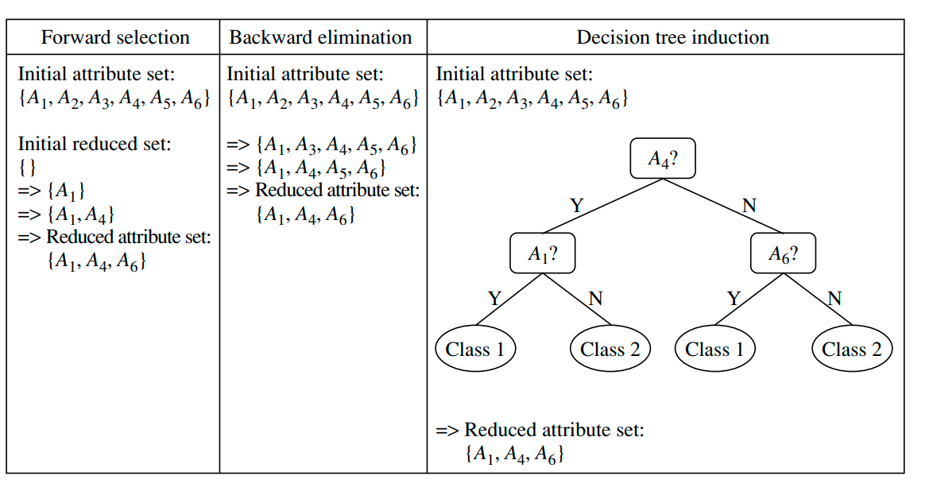
Attribute Subset selection
Data Transformation

Slide 22
Attribute construction
Data Transformation
Creation of new attribute…..

Slide 23
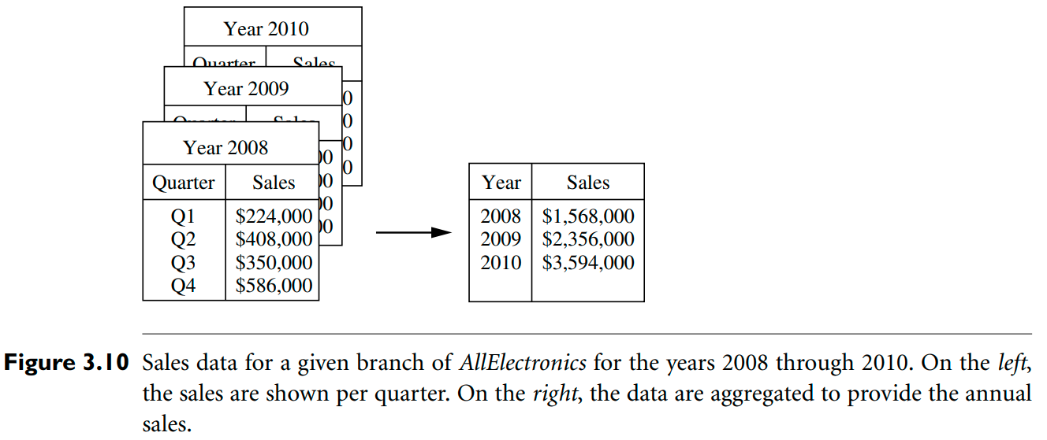
Aggregation
Data Transformation
From quarterly to yearly……

Slide 24



Normalization
Data Transformation
Data Transformation
To give all attributes an equal weight normalization is useful. Normalization is recommended for classification and clustering.
Min-max normalization
z-score normalization
Decimal scaling

Slide 25
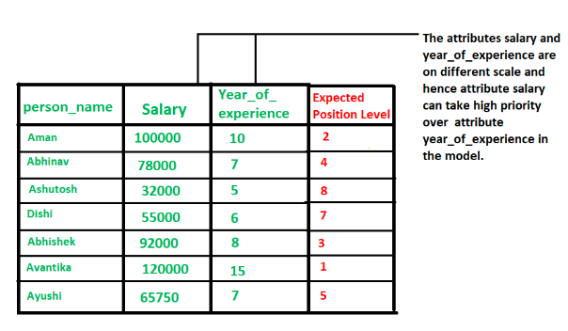
Examples related to Normalization
Data Transformation

Slide 26
Advantages or disadvantages of Normalization
Data Transformation
Advantages:
Improved performance of machine learning algorithms: Normalization can help to improve the performance of machine learning algorithms by scaling the input features to a common scale. This can help to reduce the impact of outliers and improve the accuracy of the model.
Better handling of outliers: Normalization can help to reduce the impact of outliers by scaling the data to a common scale, which can make the outliers less influential.
Improved interpretability of results: Normalization can make it easier to interpret the results of a machine learning model, as the inputs will be on a common scale.
Better generalization: Normalization can help to improve the generalization of a model, by reducing the impact of outliers and by making the model less sensitive to the scale of the inputs.

Slide 27
Data Transformation
Normalization
Disadvantages:
Loss of information: Normalization can result in a loss of information if the original scale of the input features is important.
Impact on outliers: Normalization can make it harder to detect outliers as they will be scaled along with the rest of the data.
Impact on interpretability: Normalization can make it harder to interpret the results of a machine learning model, as the inputs will be on a common scale, which may not align with the original scale of the data.
Additional computational costs: Normalization can add additional computational costs to the data mining process, as it requires additional processing time to scale the data.
In conclusion, data normalization can have both advantages and disadvantages. It can improve the performance of machine learning algorithms and make it easier to interpret the results. However, it can also result in a loss of information and make it harder to detect outliers. It’s important to weigh the pros and cons of data normalization and carefully assess the risks and benefits before implementing it.

Slide 28
Dimensionality reduction is the process of reducing the number of random variables or attributes under consideration. Dimensionality reduction methods include wavelet transforms and principal components analysis,which transform or project the original data onto a smaller space. Attribute subset selection is a method of dimensionality reduction in which irrelevant, weakly relevant, or redundant attributes or dimensions are detected and removed (Section 3.4.4).

Slide 29
Numerosity reduction techniques replace the original data volume with alternative, smaller forms of data representation. These techniques may be parametric or nonparametric. For parametric methods, a model is used to estimate the data, so that typically only the data parameters need to be stored, instead of the actual data. Regression and log-linear models are examples. Nonparametric methods for storing reduced representations of the data include histograms, clustering, sampling, and data cube aggregation.

Slide 30
In data compression, transformations are applied so as to obtain a reduced or “compressed” representation of the original data. If the original data can be reconstructed from the compressed data without any information loss, the data reduction is called lossless. If, instead, we can reconstruct only an approximation of the original data, then the data reduction is called lossy. There are several lossless algorithms for string compression; however, they typically allow only limited data manipulation. Dimensionality reduction and numerosity reduction techniques can also be considered forms of data compression

